Slide 1
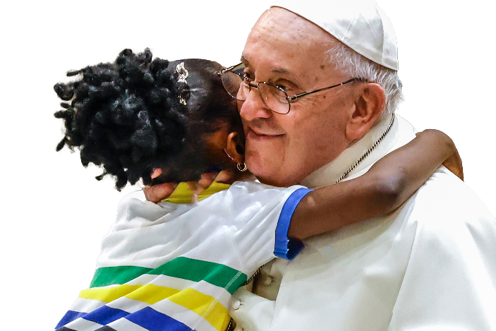
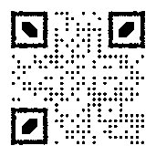
Your gift is the answer to someone’s prayer
Every day, God showers us with blessings so we will have gifts to share.
Your support serves those in our community who need our care today.
catholiccampaign.com.au

Slide 2
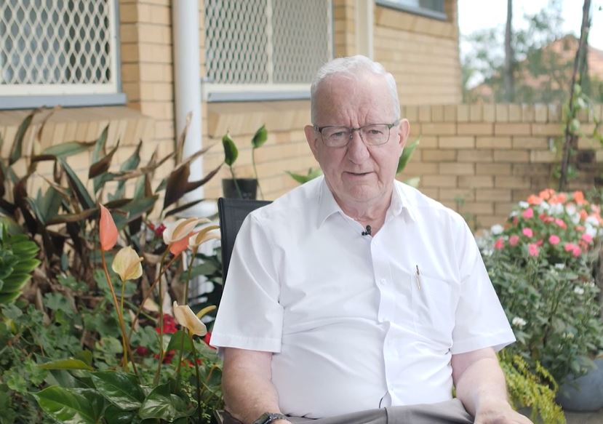
THE PRIESTS FOUNDATION
Your gift ensures our elderly priests have the support they need to retire with dignity; knowing they have a community of the faithful invested in their wellbeing.

Slide 3
CENTACARE PASTORAL MINISTRIES
Your gift to support Centacare ministries help create an inclusive society where we can walk alongside those who need our love and care.

Slide 4
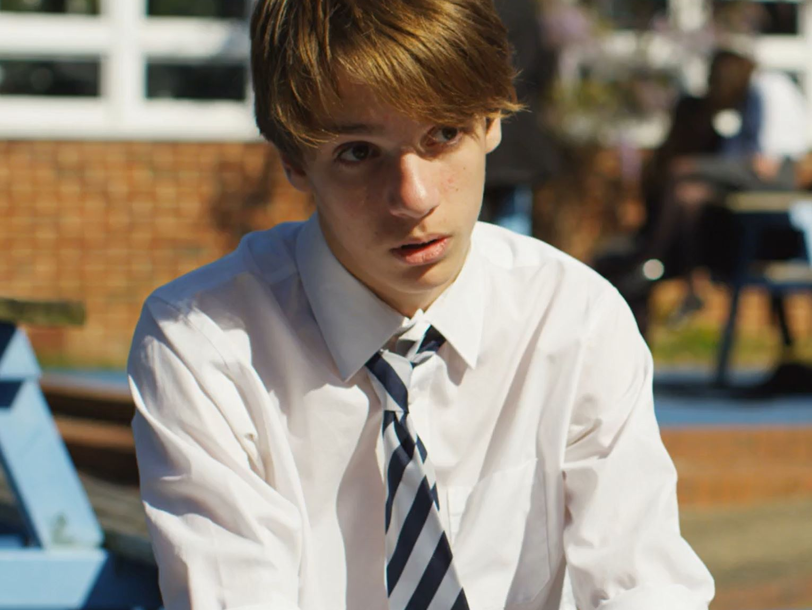
MARY MACKILLOP BURSARY FUND
You give children living in hardship the love and care of a Catholic school community. With your support, these young people have access to a quality Catholic education.

Slide 5
HOLY SPIRIT SEMINARY
Give future priests the support they need to answer God’s call to priesthood.
Your gift ensures the future of our faith.

