Slide 1
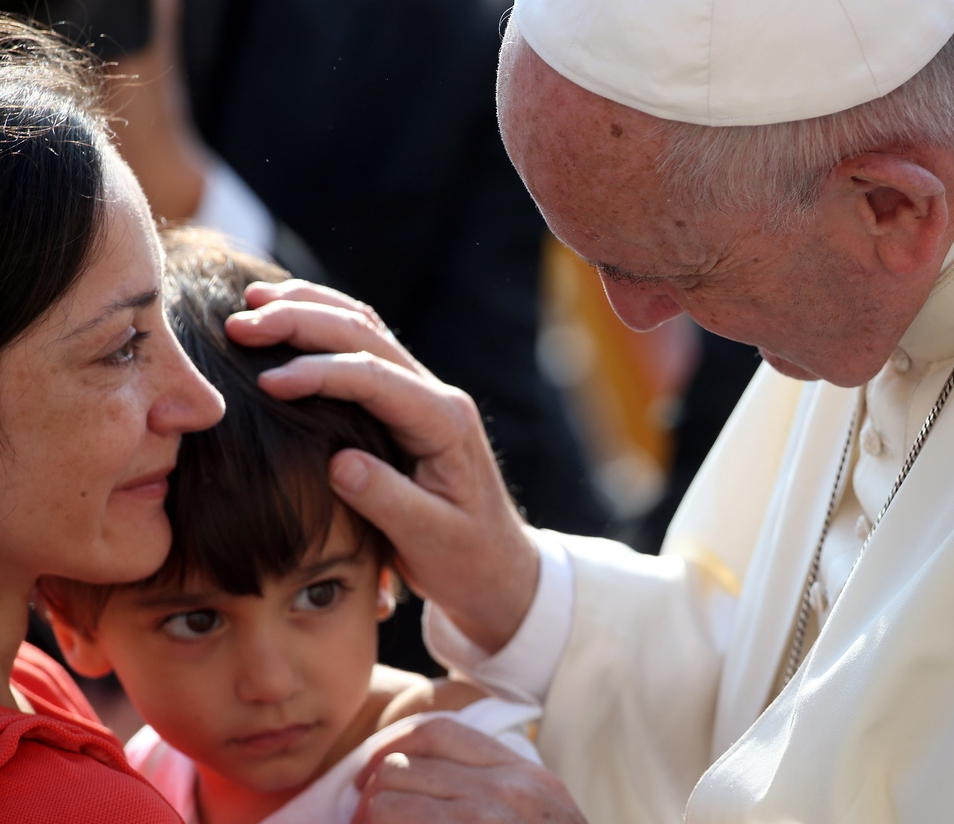

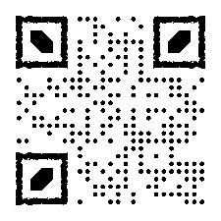
Be the face of Christ for others
Through your gift, you open the door of faith and allow God’s mercy to flow through us into the lives of those in need, so that they may see in the face of the Church, and in each of us, the face of Christ.
20 August 2023 catholiccampaign.com.au

Slide 2
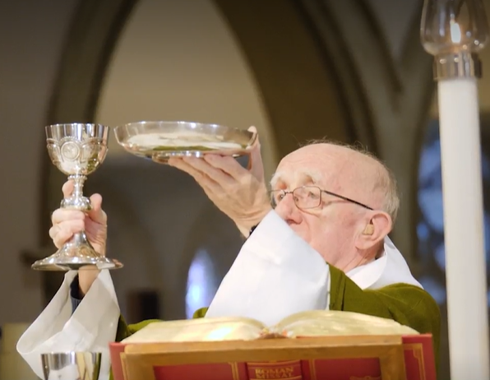
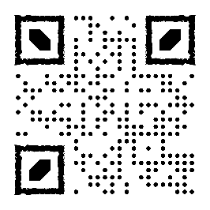
THE PRIESTS FOUNDATION
Your gift ensures our elderly priests have the support they need to retire with dignity; knowing they have a community of the faithful invested in their wellbeing.
20 August 2023 catholiccampaign.com.au

Slide 3
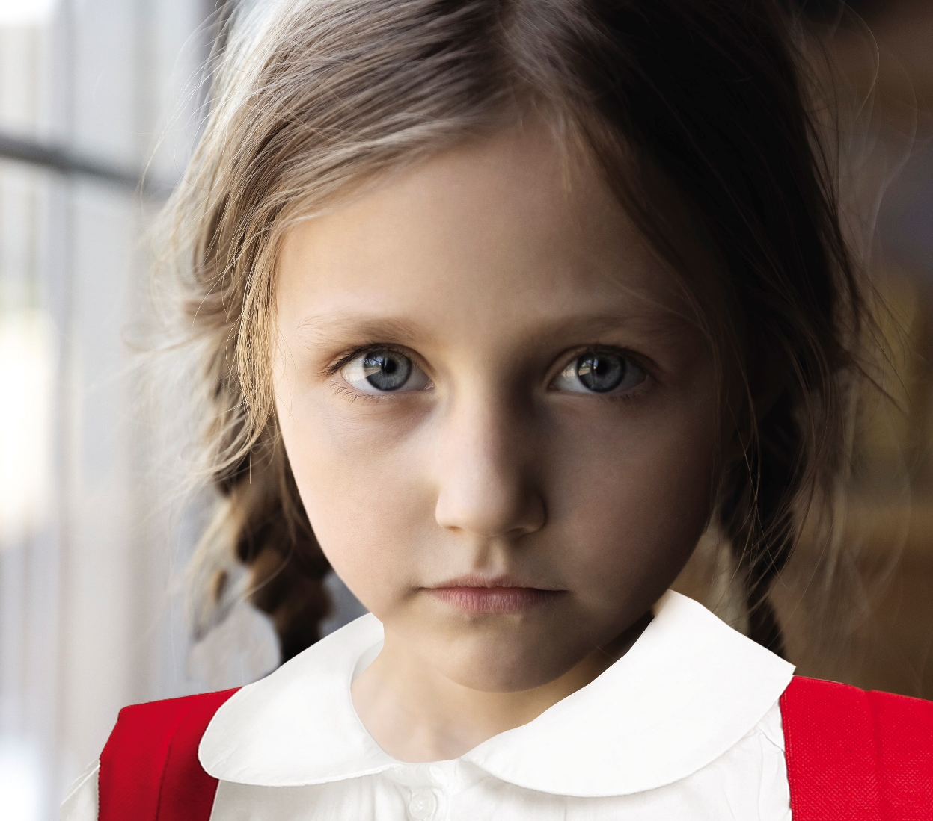
MARY MACKILLOP BURSARY FUND
You give children living in hardship the love and care of a Catholic school community.
With your support, these young people have access to a quality Catholic education.
20 August 2023 catholiccampaign.com.au
catholiccampaign.com.au

Slide 4
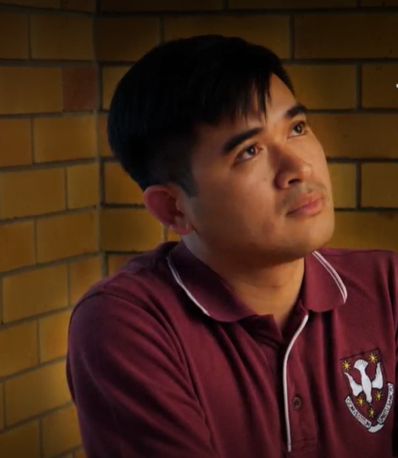
HOLY SPIRIT SEMINARY
Give future priests the support they need to answer God’s call to priesthood and stay the course.
Your gift ensures the future of our faith.
20 August 2023 catholiccampaign.com.au

Slide 5
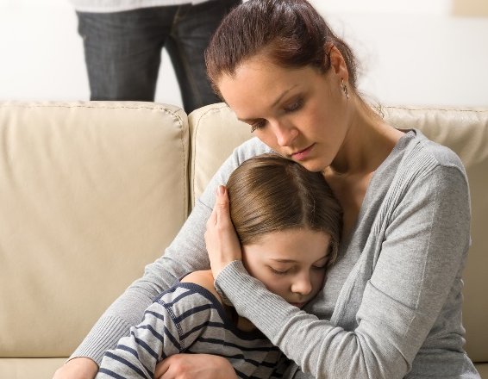
CENTACARE
Your gift provides an inclusive society where those in dire circumstances are supported and empowered to create a future without fear or violence.
With your support, they provide ministries such as:
Homelessness and housing support
Hospital chaplaincy
Domestic and family violence support
Catholic Psychiatric Pastoral Care
Murri Ministry
20 August 2023 catholiccampaign.com.au

